Slide 1

Intangibles Estimation
By Survey
Payment Cards Method
Price Sensitivity Method
Contingent Valuation Method

Slide 2
Payment Cards Method
Asked to choose Willingness To Pay(WTP) point estimate or range from list on card

Slide 3
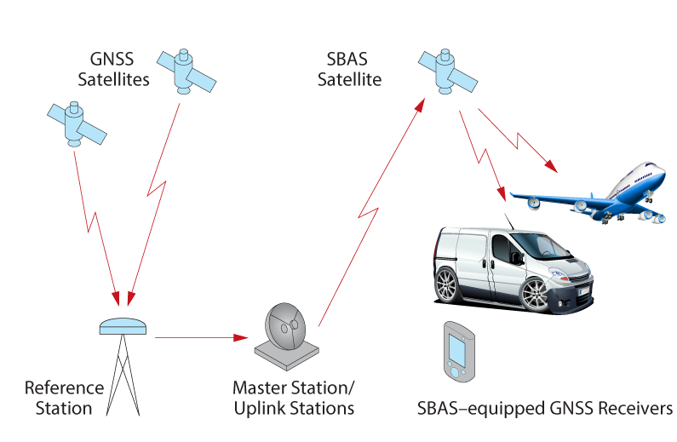
Example
Mobile phone Location Based Service(LBS) is now provided with 10~35m location accuracy utilizing map matching technics of GPS satellites.
Korean government is considering to deploy Satellite based augmenting service(SBAS) which is capable of offering 1~3m location accuracy.

Slide 4
Example
18. Is your CP capable of using LBS ?
① Yes ☞ [Go #19] ② No ☞ [Go to #18-1]
18-1. Are you willingly to purchase CP which is capable of using LBS ?
① Yea ② No ☞ [Skip this Section]
19. Mobile phone Location Based Service(LBS) is now provided with 10~35m location accuracy, such that lot of difficulties are being experienced. If you are able to upgrade this resolution up to 3m accuracy, how much are you willingly to pay for the upgrade?
① ₩100/month② ₩500/month ③ ₩1,000/month ④ ₩1,500/month ⑤ ₩3,000/month
⑥ Nothing to pay

Slide 5
PSM:
Price Sensitivity Measurement
Determine Fair Prices From Subjective Awareness of Customers

Slide 6
1. PSM Introduction
1. Backgrounds
Developed by Netherland economist Peter H. Westendorp
Published in Journal of Marketing News(1982. 05)
Progressed as a fair pricing methodology in Japan
2. Characteristics
Investigation of price perception by confirming resistance level of customer price
(Too Cheap, Cheap, Expensive, Too Expensive)
Obtainment of results by calculating the purchase intention rate on each level
Respondents are supposed to be familiar with the product
Use of new products as well as existing ones
Visualization of analysis results
Applicability from relatively small sample sizes

Slide 7
2. Question
Measuring “Price Perception” through the four questions
Q1. “At what price would you consider the product to be a good buy for the money”?(Good value/Cheap)
Q2. “At what price would you consider the product starting to get expensive, so that it is not out of question, but you would have to give some thought to buying it”?(expensive)
Q3. “At what price would you consider the product to be so expensive that you would not consider buying it”?(too expensive)
Q4. “At what price would you consider the product to be priced so low that you would feel the quality couldn’t be very good”(too cheap)
Direction of Presentation
 |  |  |  |  |  | V
1200 | 1300 | 1400 | 1500 | 1600 | 1700 | 1800 | 1900 | 2000 | 2100 | 2200 | 2300 | 2400 | 2500 | 2600 | 2700 | 2800 | 2900 | 3000
Direction of Presentation
 |  |  |  |  |  | Q1 |  |  |  |  | V
1200 | 1300 | 1400 | 1500 | 1600 | 1700 | 1800 | 1900 | 2000 | 2100 | 2200 | 2300 | 2400 | 2500 | 2600 | 2700 | 2800 | 2900 | 3000
Direction of Presentation
 |  |  |  |  |  | Q1 |  |  |  |  | Q2 |  |  | V
1200 | 1300 | 1400 | 1500 | 1600 | 1700 | 1800 | 1900 | 2000 | 2100 | 2200 | 2300 | 2400 | 2500 | 2600 | 2700 | 2800 | 2900 | 3000
Direction of Presentation
 |  |  | V |  |  | Q1 |  |  |  |  | Q2 |  |  | Q3
1200 | 1300 | 1400 | 1500 | 1600 | 1700 | 1800 | 1900 | 2000 | 2100 | 2200 | 2300 | 2400 | 2500 | 2600 | 2700 | 2800 | 2900 | 3000

Slide 8
3. Analysis
1. Frequencies
Prices (cheap) (expensive) (too expensive) (too cheap)
( 1) ₩ 1,200 0 0 0 2
( 2) ₩ 1,300 2 0 0 12
( 3) ₩ 1,400 2 1 0 9
( 4) ₩ 1,500 11 2 0 43
( 5) ₩ 1,600 32 5 2 26
( 6) ₩ 1,700 11 21 1 7
( 7) ₩ 1,800 34 7 13 1
( 8) ₩ 1,900 0 36 3 0
( 9) ₩ 2,000 4 13 30 0
(10) ₩ 2,100 2 12 11 0
(11) ₩ 2,200 1 2 24 0
(12) ₩ 2,300 1 1 8 0
(13) ₩ 2,400 0 0 8 0
(14) ₩ 2,500 0 0 0 0
(15) ₩ 2,600 0 0 0 0

Slide 9
3. Analysis
2. Cumulative Frequencies
Starting From Highest Price (Cheap, Too Cheap),
Starting From Lowest Price (Expensive, Too Expensive)
Prices (cheap) (expensive) (too expensive) (too cheap)
(cumulative%) (cumulative %) (cumulative %) (cumulative %)
( 1) ₩ 1,200 100 0 0 100
( 2) ₩ 1,300 100 0 0 98
( 3) ₩ 1,400 98 1 0 86
( 4) ₩ 1,500 96 3 0 77
( 5) ₩ 1,600 85 8 2 34
( 6) ₩ 1,700 53 29 3 8
( 7) ₩ 1,800 42 36 16 1
( 8) ₩ 1,900 8 72 19 0
( 9) ₩ 2,000 8 85 49 0
(10) ₩ 2,100 4 97 60 0
(11) ₩ 2,200 2 99 84 0
(12) ₩ 2,300 1 100 92 0
(13) ₩ 2,400 0 100 100 0
(14) ₩ 2,500 0 100 100 0
(15) ₩ 2,600 0 100 100 0

Slide 10
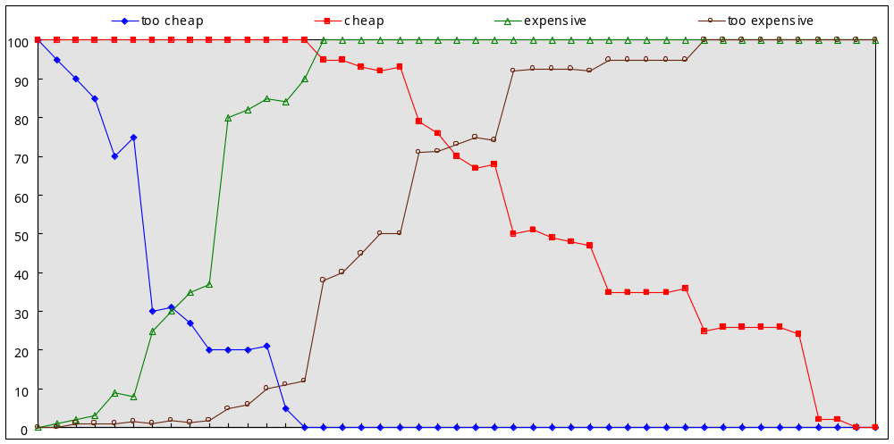
3. Analysis
3. Visualization
IDP(InDifference Price)
PME(Marginal Expensiveness)
PMC(Marginal Cheapness)
OPP(Optimal Price)

Slide 11
3. Analysis¹
4. Terminology
IDP
(Indifference Price Point)
☞ Price which is thought NOT to be cheap nor expensive
☞ May refer to “Normal Price”
☞ Meaning : Average price or Market Leader price
OPP
(Optimal Price Point)
☞ High Price point which is thought NOT to be too cheap nor too expensive
☞ Least price resistance point to customers
☞ Meaning : Optimal Price Point to Customers
PMC
(Point of Marginal Cheapness)
☞ Marginal Cheapness which is thought to be doubtful quality
☞ Meaning : Lowest Price which customers may willingly to pay
PME
(Point of marginal Expensiveness)
☞ Marginal Cheapness which is thought to be non-purchase resistance
☞ Meaning : Highest Price which customers may willingly to pay
APR
(Acceptable Price Range)
☞ Price Range between PMC and PME
☞ Meaning : Price Range which customers may willingly to pay
Stress
(IDP – OPP)
☞ Degree of Price Resistance
☞ Meaning : ‘+’ allows higher price due to lower resistance,
‘-’ forces lower prices due to higher resistance.

Slide 12
Example
Mobile phone Location Based Service(LBS) is now provided with 10~35m location accuracy utilizing map matching technics of GPS satellites.
Korean government is considering to deploy Satellite based augmenting service(SBAS) which is capable of offering 1~3m location accuracy.

Slide 13
Q1. “At what monthly fee would you consider the SBA service to be a good buy for the money?”
Q2. “At what monthly fee would you consider the SBA service starting to get expensive, so that it is not out of question, but you would have to give some thought to buying it?”
Q3. “At what monthly fee would you consider the SBA service to be so expensive that you would not consider buying it?”
Q4. “At what monthly fee would you consider the SBA service to be priced so low that you would feel the quality couldn’t be very good ?”
Direction of Presentation
0 | 100 | 200 | 300 | 400 | 500 | 600 | 800 | 1,000 | 1,200 | 1,400 | 1,600 | 1,800 | 2,000 | 2,200 | 2,400 | 2,600 | 2,800 | 3,000
Direction of Presentation
0 | 100 | 200 | 300 | 400 | 500 | 600 | 800 | 1,000 | 1,200 | 1,400 | 1,600 | 1,800 | 2,000 | 2,200 | 2,400 | 2,600 | 2,800 | 3,000
Direction of Presentation
0 | 100 | 200 | 300 | 400 | 500 | 600 | 800 | 1,000 | 1,200 | 1,400 | 1,600 | 1,800 | 2,000 | 2,200 | 2,400 | 2,600 | 2,800 | 3,000
Direction of Presentation
0 | 100 | 200 | 300 | 400 | 500 | 600 | 800 | 1,000 | 1,200 | 1,400 | 1,600 | 1,800 | 2,000 | 2,200 | 2,400 | 2,600 | 2,800 | 3,000

Slide 14
CVM:
Contingent Valuation Method
Useful tool for learning about preferences of public goods and accepted for policy analysis

Slide 15
1. CVM Introduction
1. CVM Backgrounds
around for 30 years
thinking has been influenced by three studies:
  - 1989 Exxon Valdez Oil Spill (Carson et al., 1992)
  - Exxon symposium (Hausman, 1993)
  - Blue Ribbon Panel by NOAA to assess reliability of CV for use in assessing lost passive
  use values resulting from oil spills (Arrow et al. 1993)
2. CVM Characteristics
most widely used approach for valuing public goods
conducted in over 40 counties and valuing clean water, air, wilderness, recreation, endangered species, tropical forests, and many non-environmental health issues
CVM surveys have been demand driven, but have fallen victim to some poor problems in one way or another
must have pretesting, good interviewers, large sample size, adequate budget.

Slide 16
1. CVM Analysis
1. CVM Questionnaire
B_{i}^{u}
YES
B_{i}
YES
Higher Price
($2X)
NO
Initial Price
($X)
B_{i}^{d}
YES
NO
Lower Price
($X/2)
NO
2. CVM Equations
π ^{yy} (B_{i},B^{u}_{i})=Prob{B^{u}_{i}≤WTP_{i}} = 1 - F(B^{u}_{i};θ)
π ^{yn} (B_{i},B^{u}_{i})=Prob{B_{i}≤WTP_{i}<B^{u}_{i}}=F(B^{u}_{i};θ) - F(B_{i};θ)
π ^{ny} (B_{i},B^{d}_{i})=Prob{B^{d}_{i}≤WTP_{i}<B_{i}}=F(B_{i};θ) - F(B^{d}_{i};θ)
π ^{nn} (B_{i},B^{d}_{i})=Prob{WTP_{i}<B^{d}_{i}}=F(B^{d}_{i};θ)

Slide 17

1. CVM Analysis
4. CVM Outcomes
ln L(θ) = Σ^{N}_{i = 1} {d^{yy}_{i} lnπ^{yy}(B_{i} , B^{u}_{i} ) + d^{yn}_{i} lnπ^{yn} (B_{i} , B^{u}_{i}) + d^{ny}_{i} lnπ^{ny} (B_{i}, B^{d}_{i}) + d^{nn}_{i} lnπ^{nn} (B_{i}, B^{d}_{i})}
→ ∂ ln L(θ)/∂θ = 0
TSP or LIMDEP s/w
or
Nonparametric Estimation

Slide 18
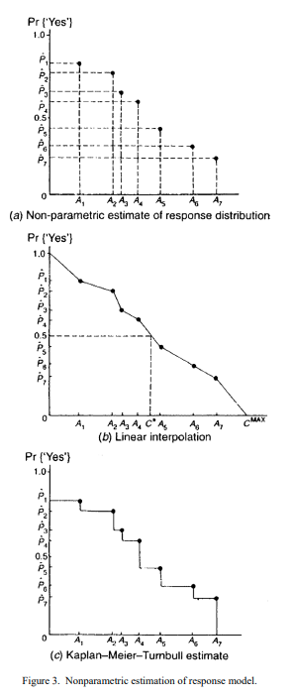
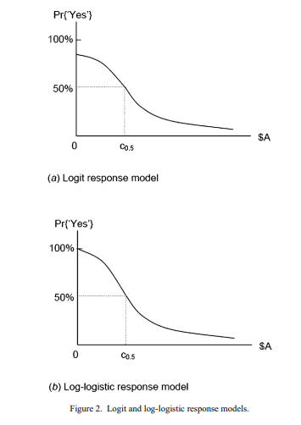
3. CVM Acceptance Probability Example

Slide 19
Example
Mobile phone Location Based Service(LBS) is now provided with 10~35m location accuracy utilizing map matching technics of GPS satellites.
Korean government is considering to deploy Satellite based augmenting service(SBAS) which is capable of offering 1~3m location accuracy.

Slide 20
Example
Q. How much would you like to pay more monthly fee for upgrading your mobile phone that
is capable of providing the SBAS service ?
(※ If you don’t like to pay more, please check here ( ), and please go to the next question.)
 | Base Amount |  | (1) |  | (2)
Amount 1 | \100 | ① Yes → Go to (1) ② No → Go to (2) | \200 | ① Yes ② No | \50 | ① Yes ② No
Amount 2 | \500 | ① Yes → Go to (1) ② No → Go to (2) | \1,000 | ① Yes ② No | \250 | ① Yes ② No
Amount 3 | \1,000 | ① Yes → Go to (1) ② No → Go to (2) | \2,000 | ① Yes ② No | \500 | ① Yes ② No
Amount 4 | \1,500 | ① Yes → Go to (1) ② No → Go to (2) | \3,000 | ① Yes ② No | \750 | ① Yes ② No

